Slide 1
Parser - Peek and Match
COP 4020

Slide 2
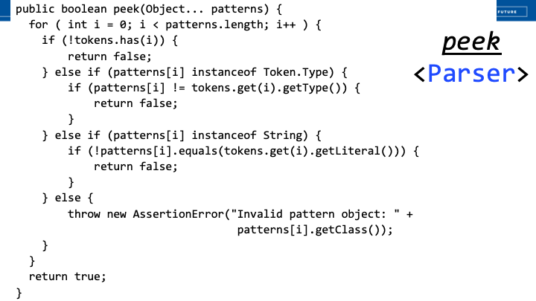

Slide 3
